Slide 1
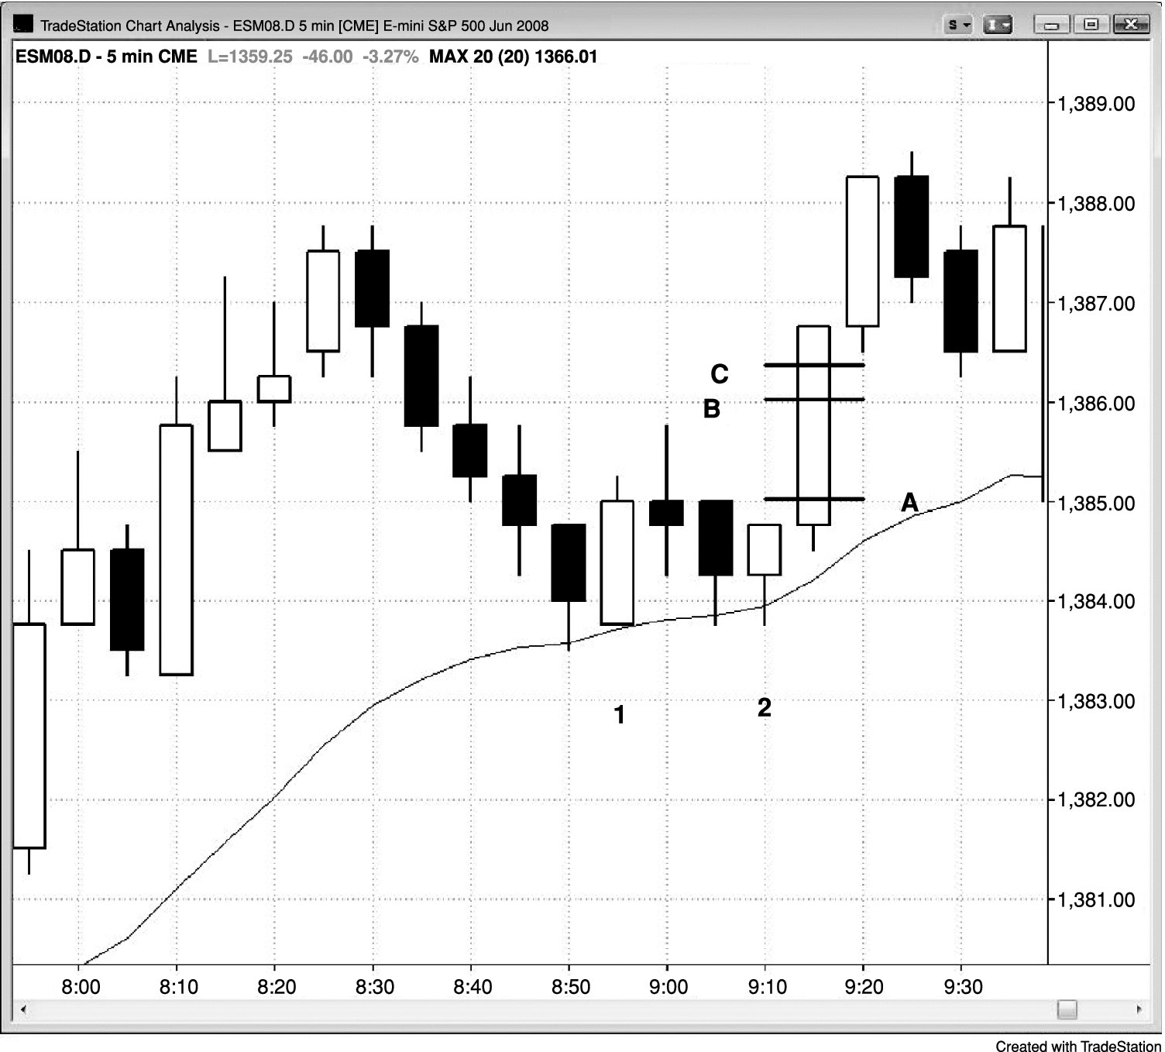
FIGURE 27.1 Need a Six-Tick Move to Make Four Ticks

